Slide 1
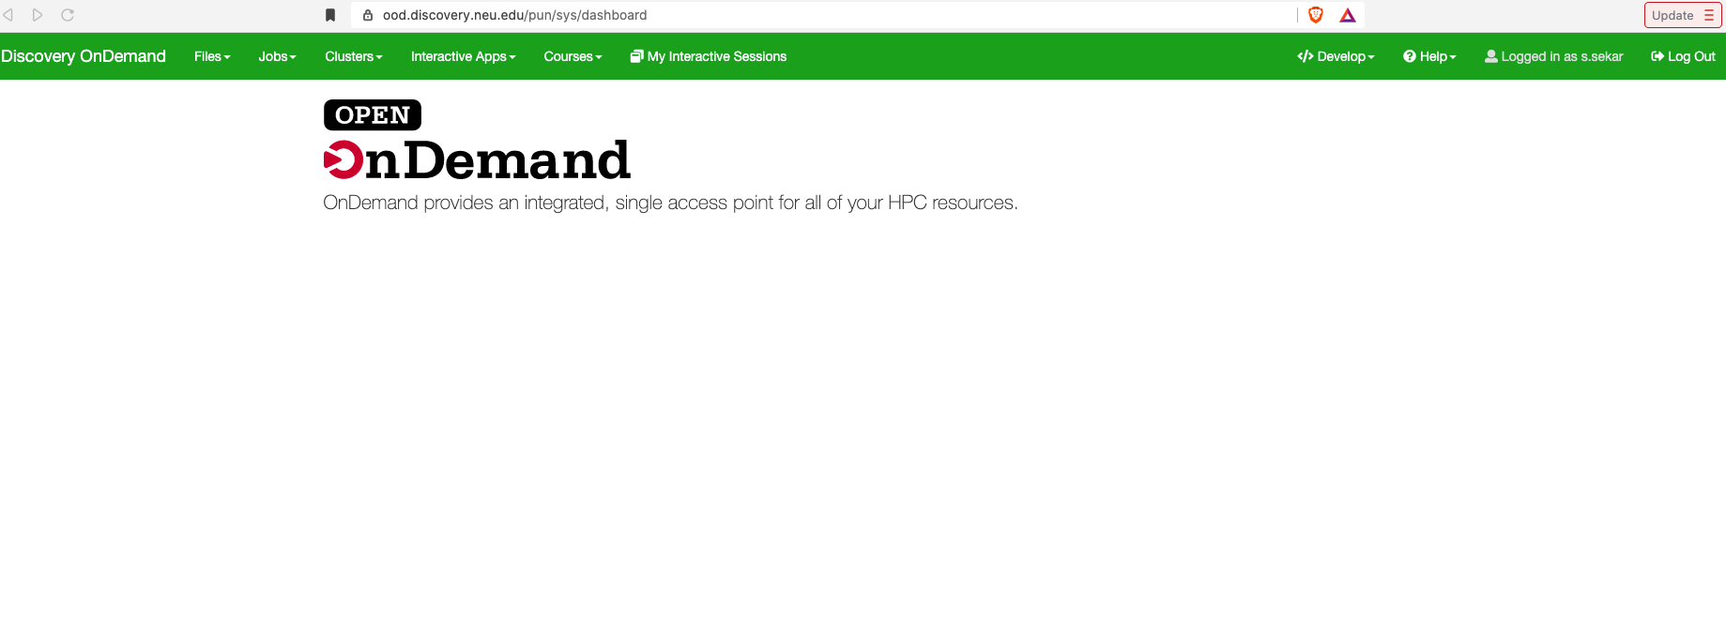
Working with Open OnDemand
May 2022
Instructor:
Bernstein, Marc

Slide 2
Overview
Introduction to OOD (Open OnDemand)
Accessing and navigating OOD
Functionalities on OOD including:
File view/upload/editing
Opening a terminal
Xfce desktop
Jupyterlab notebook (with and without custom conda env)
Checking output logs
Rstudio
Please follow along hands-on as we demo the various functionalities

Slide 3
Accessing the training material
Download the TRAINING_OOD-May2022.zip to your local machine.
2. Copy the training material to your $HOME directory using the File Explorer on OOD: https://ood.discovery.neu.edu/
Instructions: https://rc-docs.northeastern.edu/en/latest/using-ood/fileexplore.html
3. Access a Discovery Linux shell/terminal and unzip the material
(Mac: Use Terminal; Windows: Use MobaXterm, putty or powershell)
ssh <username>@login.discovery.neu.edu
$ unzip ~/TRAINING_OOD-May2022.zip

Slide 4
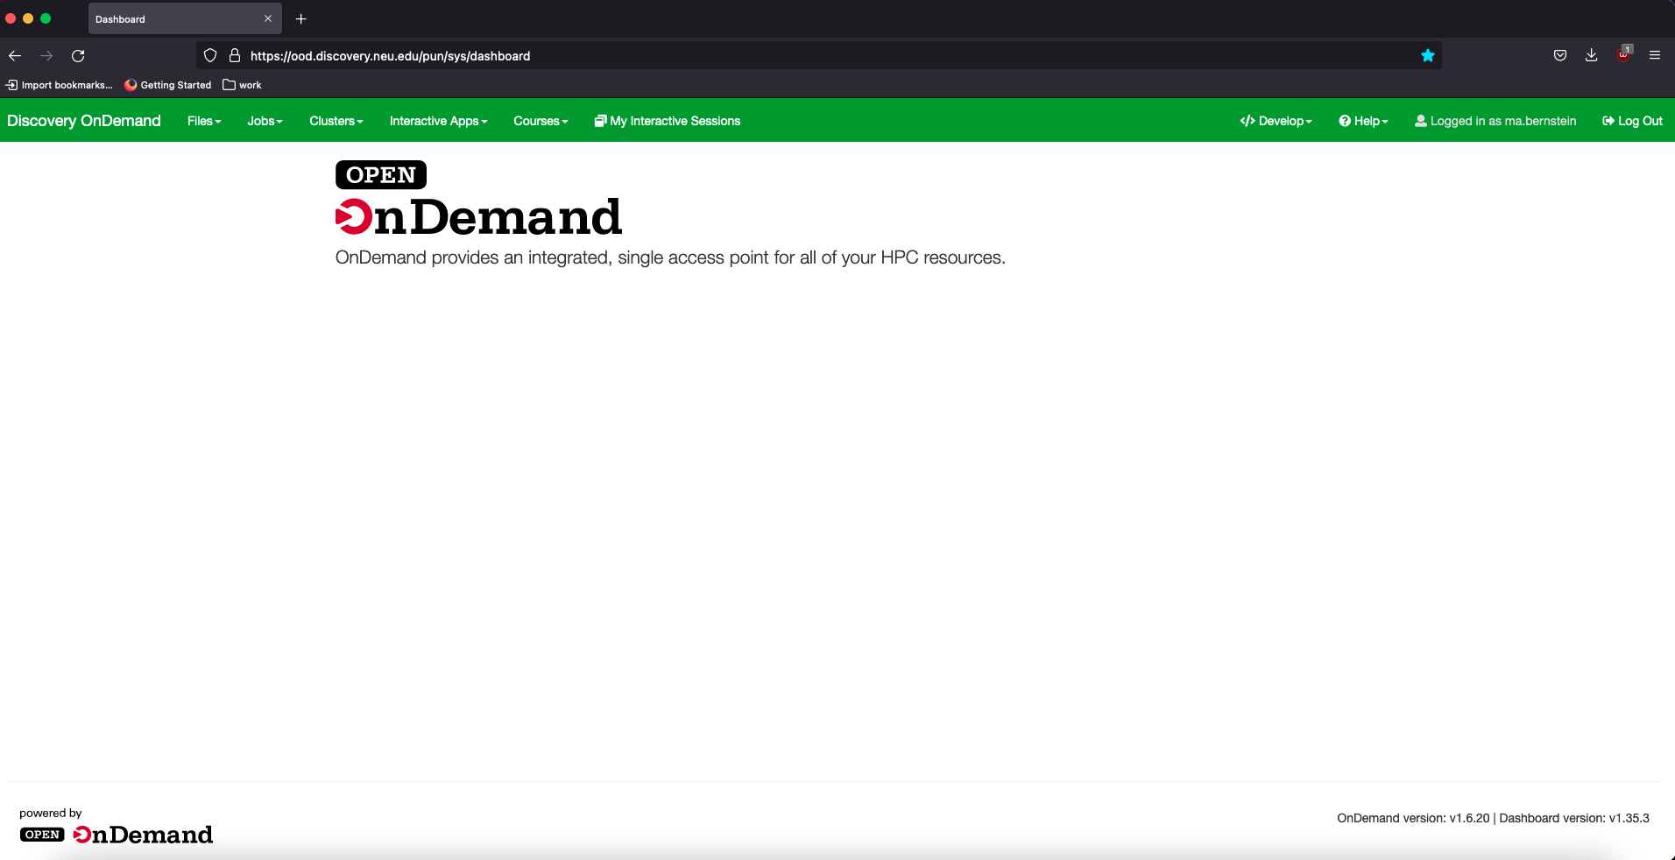
Introduction to Open OnDemand
Open OnDemand (OOD) is a web portal to the Discovery cluster. A Discovery account is necessary for you to access OOD.

Slide 5
Introduction to Open OnDemand
OOD allows you to launch a terminal, software applications, desktop environment etc. within your web browser.
Available software applications can be accessed through the “Interactive apps” drop down menu.
You may also view, download, copy, and delete files using the File Explorer feature.

Slide 6
Accessing OOD
Type the URL: https://ood.discovery.neu.edu/ on your web browser (safari currently not supported)
Enter your Northeastern username/password to login

Slide 7
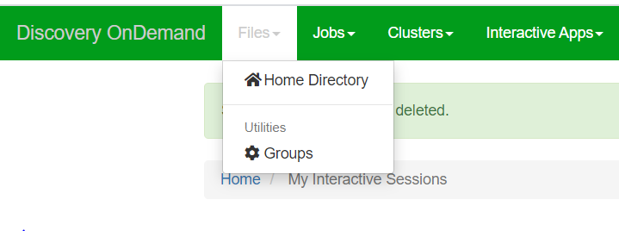
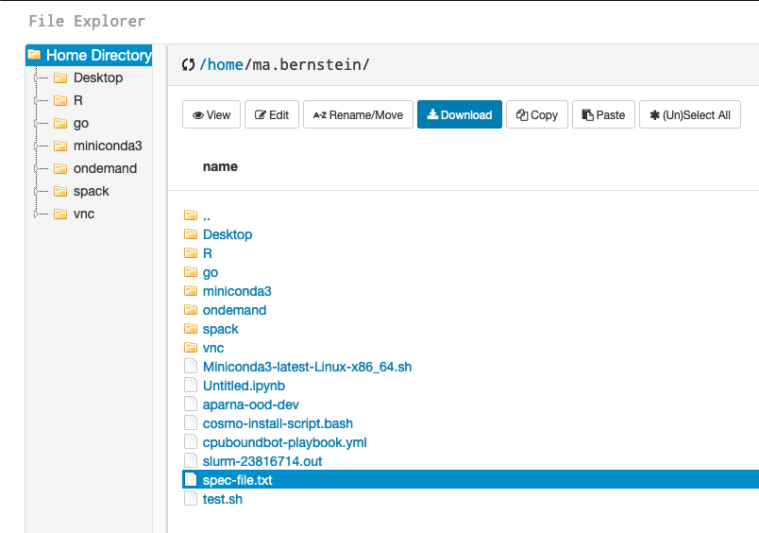
File View
To open a file, go to Files > Home Directory
Select the file you want to view and click the ‘View’ button

Slide 8
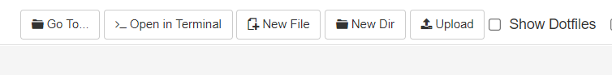
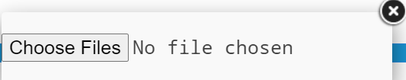
File Upload
To upload a file, click the ‘Upload’ button in the file explorer window
Select the required file/zipped folder from your computer to upload

Slide 9
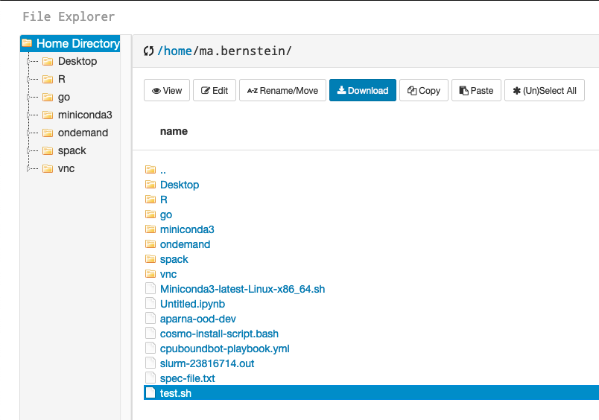
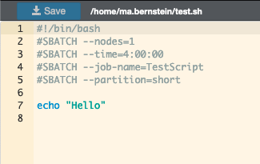
File Edit
To edit a file, select the file in the file explorer, and click the ‘Edit’ button
Edit the content as required and then click the ‘Save’ button

Slide 10
Exercise 1
In this exercise, we will use the File explorer window to copy, view, edit and upload files (demo).
Use the ‘Copy’ button to copy the training material from your local directory to your /scratch or /home directory on discovery.
Navigate to Exercise1_2 folder within TRAINING_OOD-May2022
View and edit the “Sample_slurm.sh”. Add the line “#This is an example slurm script” to this file in edit mode.
You may also try uploading a sample text file from your local computer to discovery using the upload button.

Slide 11
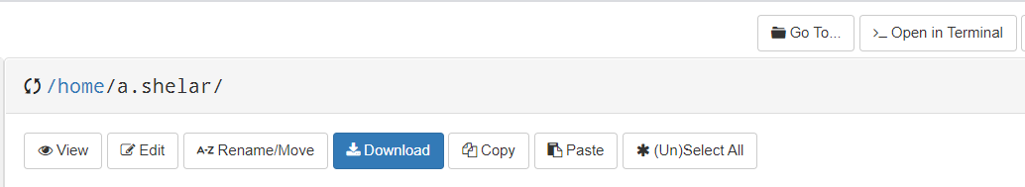
Terminal on OOD
There are 2 ways to open the terminal window on OOD :
Files -> Home Directory -> Open in Terminal

Slide 12
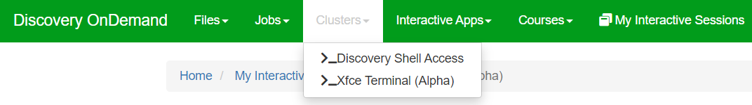
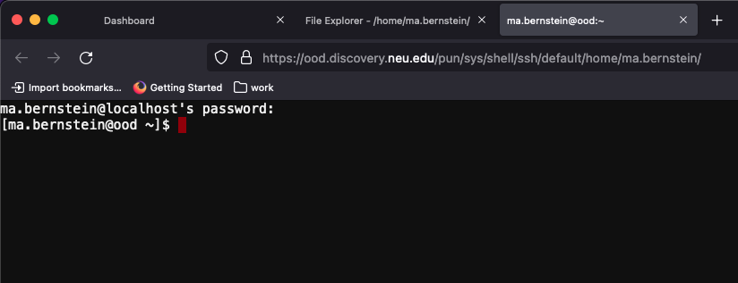
Terminal on OOD
2. Clusters -> _Discovery Shell Access

Slide 13
Exercise 2
In this exercise, we will open a terminal on OOD and submit a simple slurm job.
Navigate to /path/to/TRAINING_OOD-June2022/Exercise1_2
Open and inspect the script Sample_slurm.sh using your favorite editor
Submit the job to the queue
$ cd /path/to/TRAINING_OOD-June2022/Exercise1_2
$ vi Sample_slurm.sh
$ sbatch Sample_slurm.sh

Slide 14
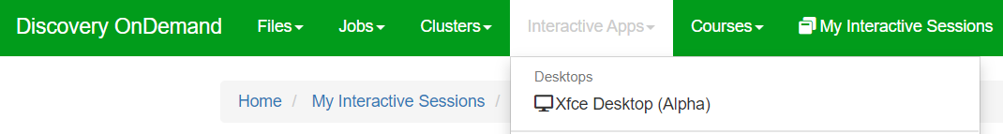
Xfce Desktop
This will launch an Xfce4 interactive desktop on a compute node.
To open an Xfce Desktop session, go to Interactive Apps > Xfce Desktop (Alpha)

Slide 15
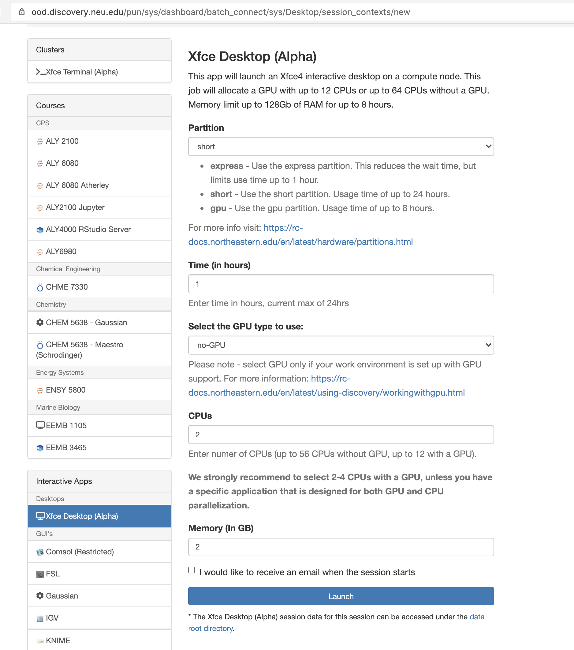
Xfce Desktop
On the form, select the partition, time, GPU/CPUs and memory required for your application. Then click ‘Launch’.
The resources requested here is what will be allocated if you were to run this using srun or sbatch - we recommend being mindful of this, especially when running computationally intensive tasks.
Running the desktop itself doesn’t need GPUs, so select GPUs on the form only if required by the application you run within the desktop.

Slide 16
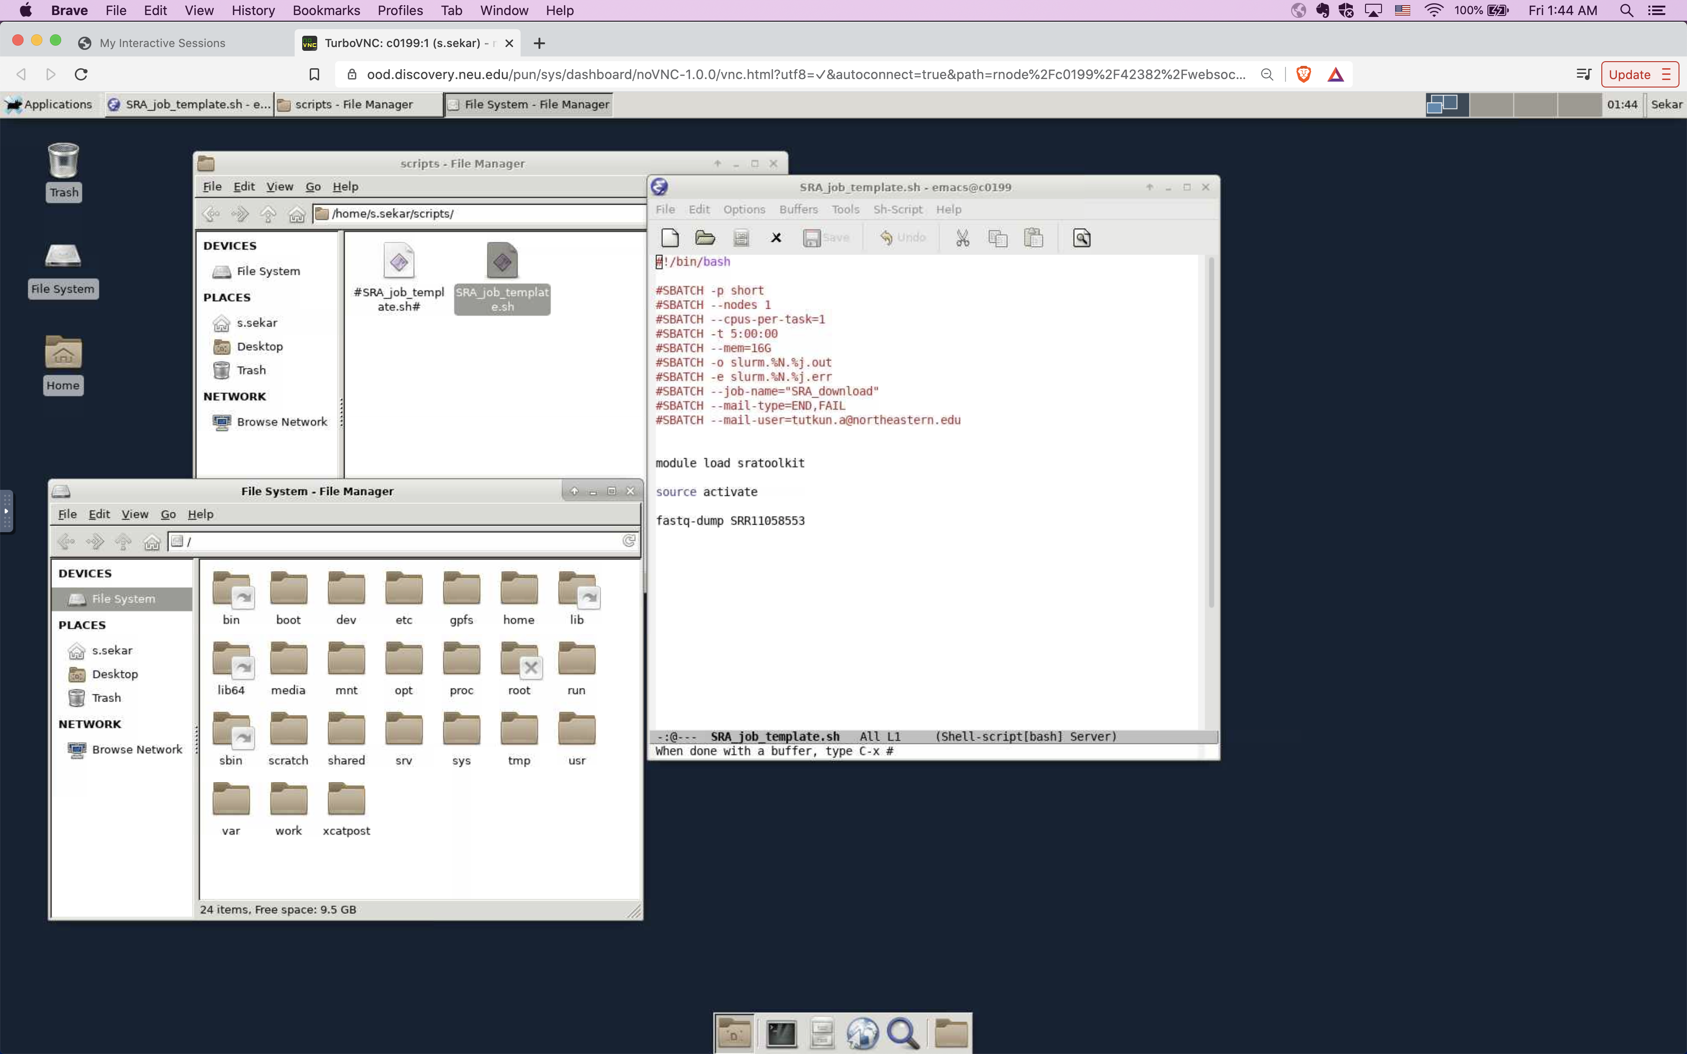
Xfce Desktop
File editing
File system view

Slide 17
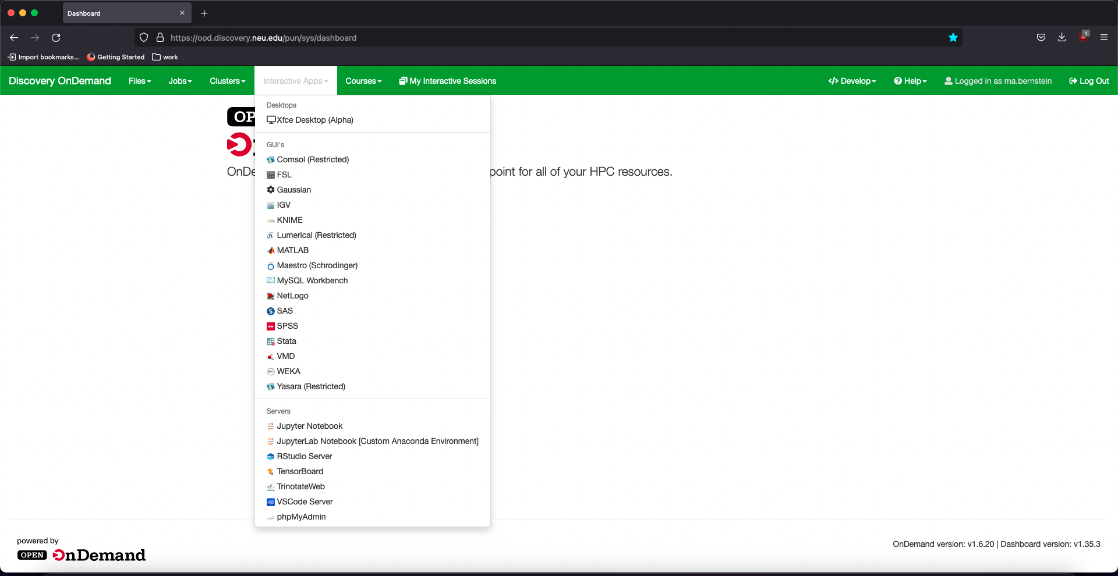
Accessing Jupyter Notebook on OOD
To launch a Jupyter Notebook on a compute node, go to Interactive Apps > Jupyter Notebook
Notes:
The Jupyter Notebook is an open-source web application that allows you to create and share documents that contain live code, equations, visualizations and narrative text. Uses include: data cleaning and transformation, numerical simulation, statistical modeling, data visualization, machine learning, and much more.

Slide 18
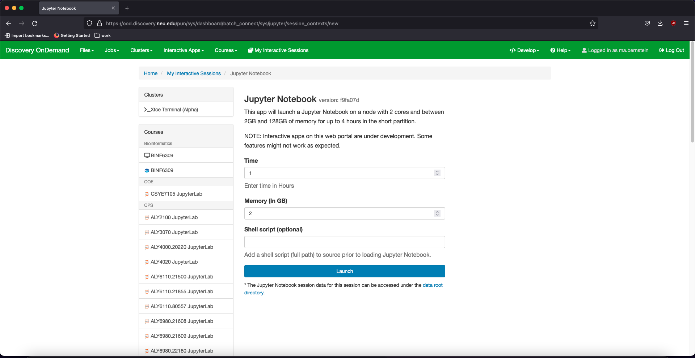
Accessing Jupyter Notebook on OOD
Select the time and memory required for your session, and click on ‘Launch’

Slide 19
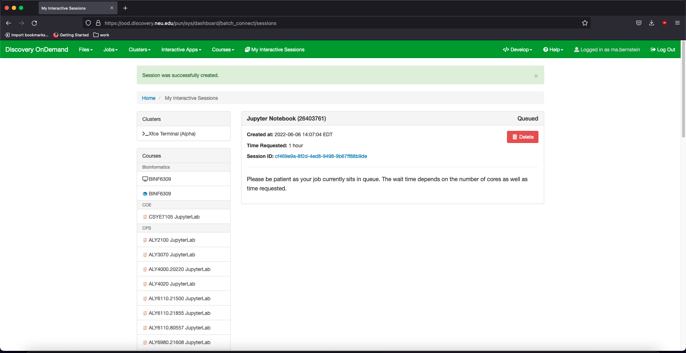
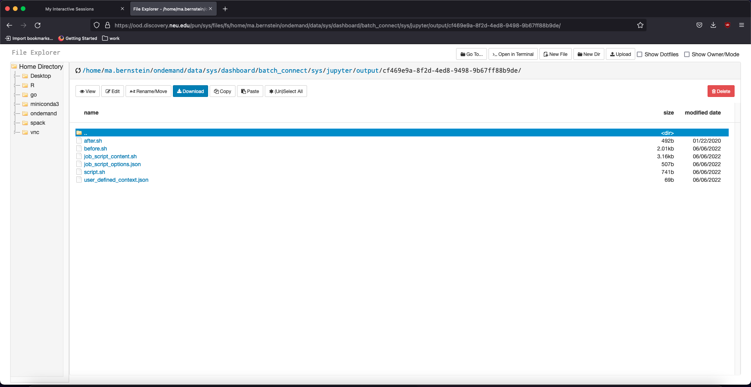
Accessing Jupyter Notebook on OOD
Click on the session ID to view session logs.
This will open a new file explorer window.
The logs and other files related to your session
will now populate here.
This is inside
/home/<username>/ondemand/data/sys/…..

Slide 20
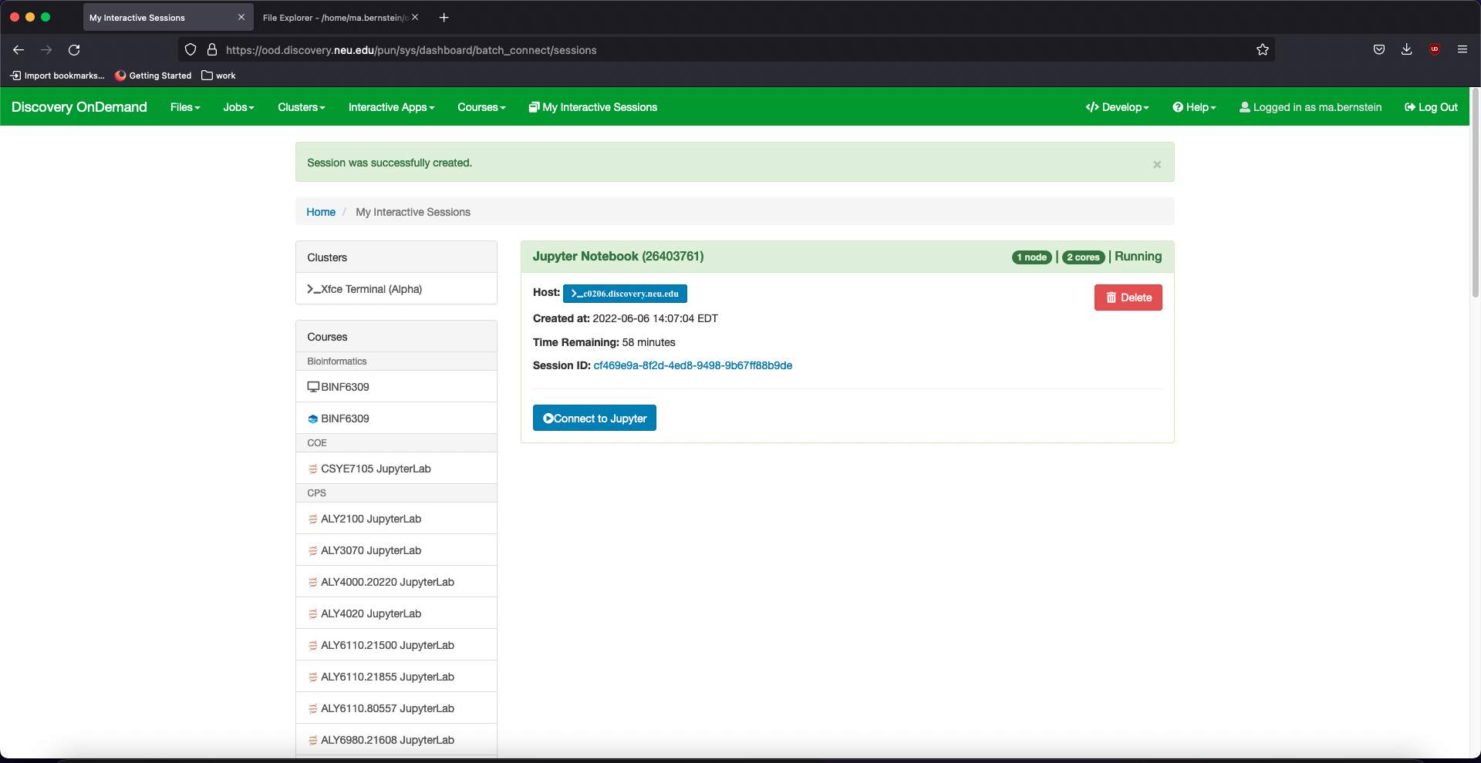
Accessing Jupyter Notebook on OOD
Once the requested resources have been allocated, you can click on ‘Connect to Jupyter’

Slide 21
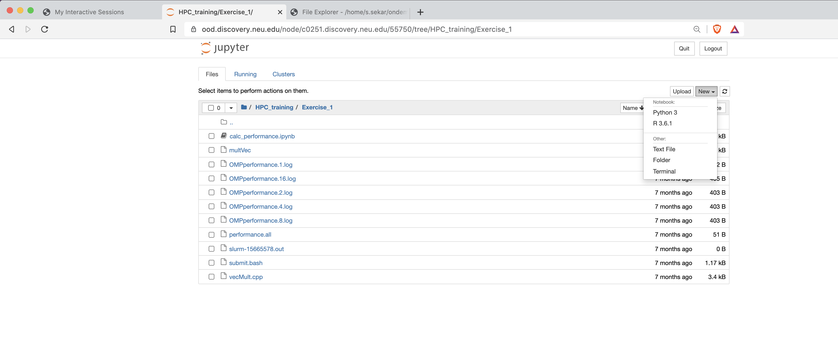
Accessing Jupyter Notebook on OOD
Open a new
notebook
Open an existing
notebook

Slide 22
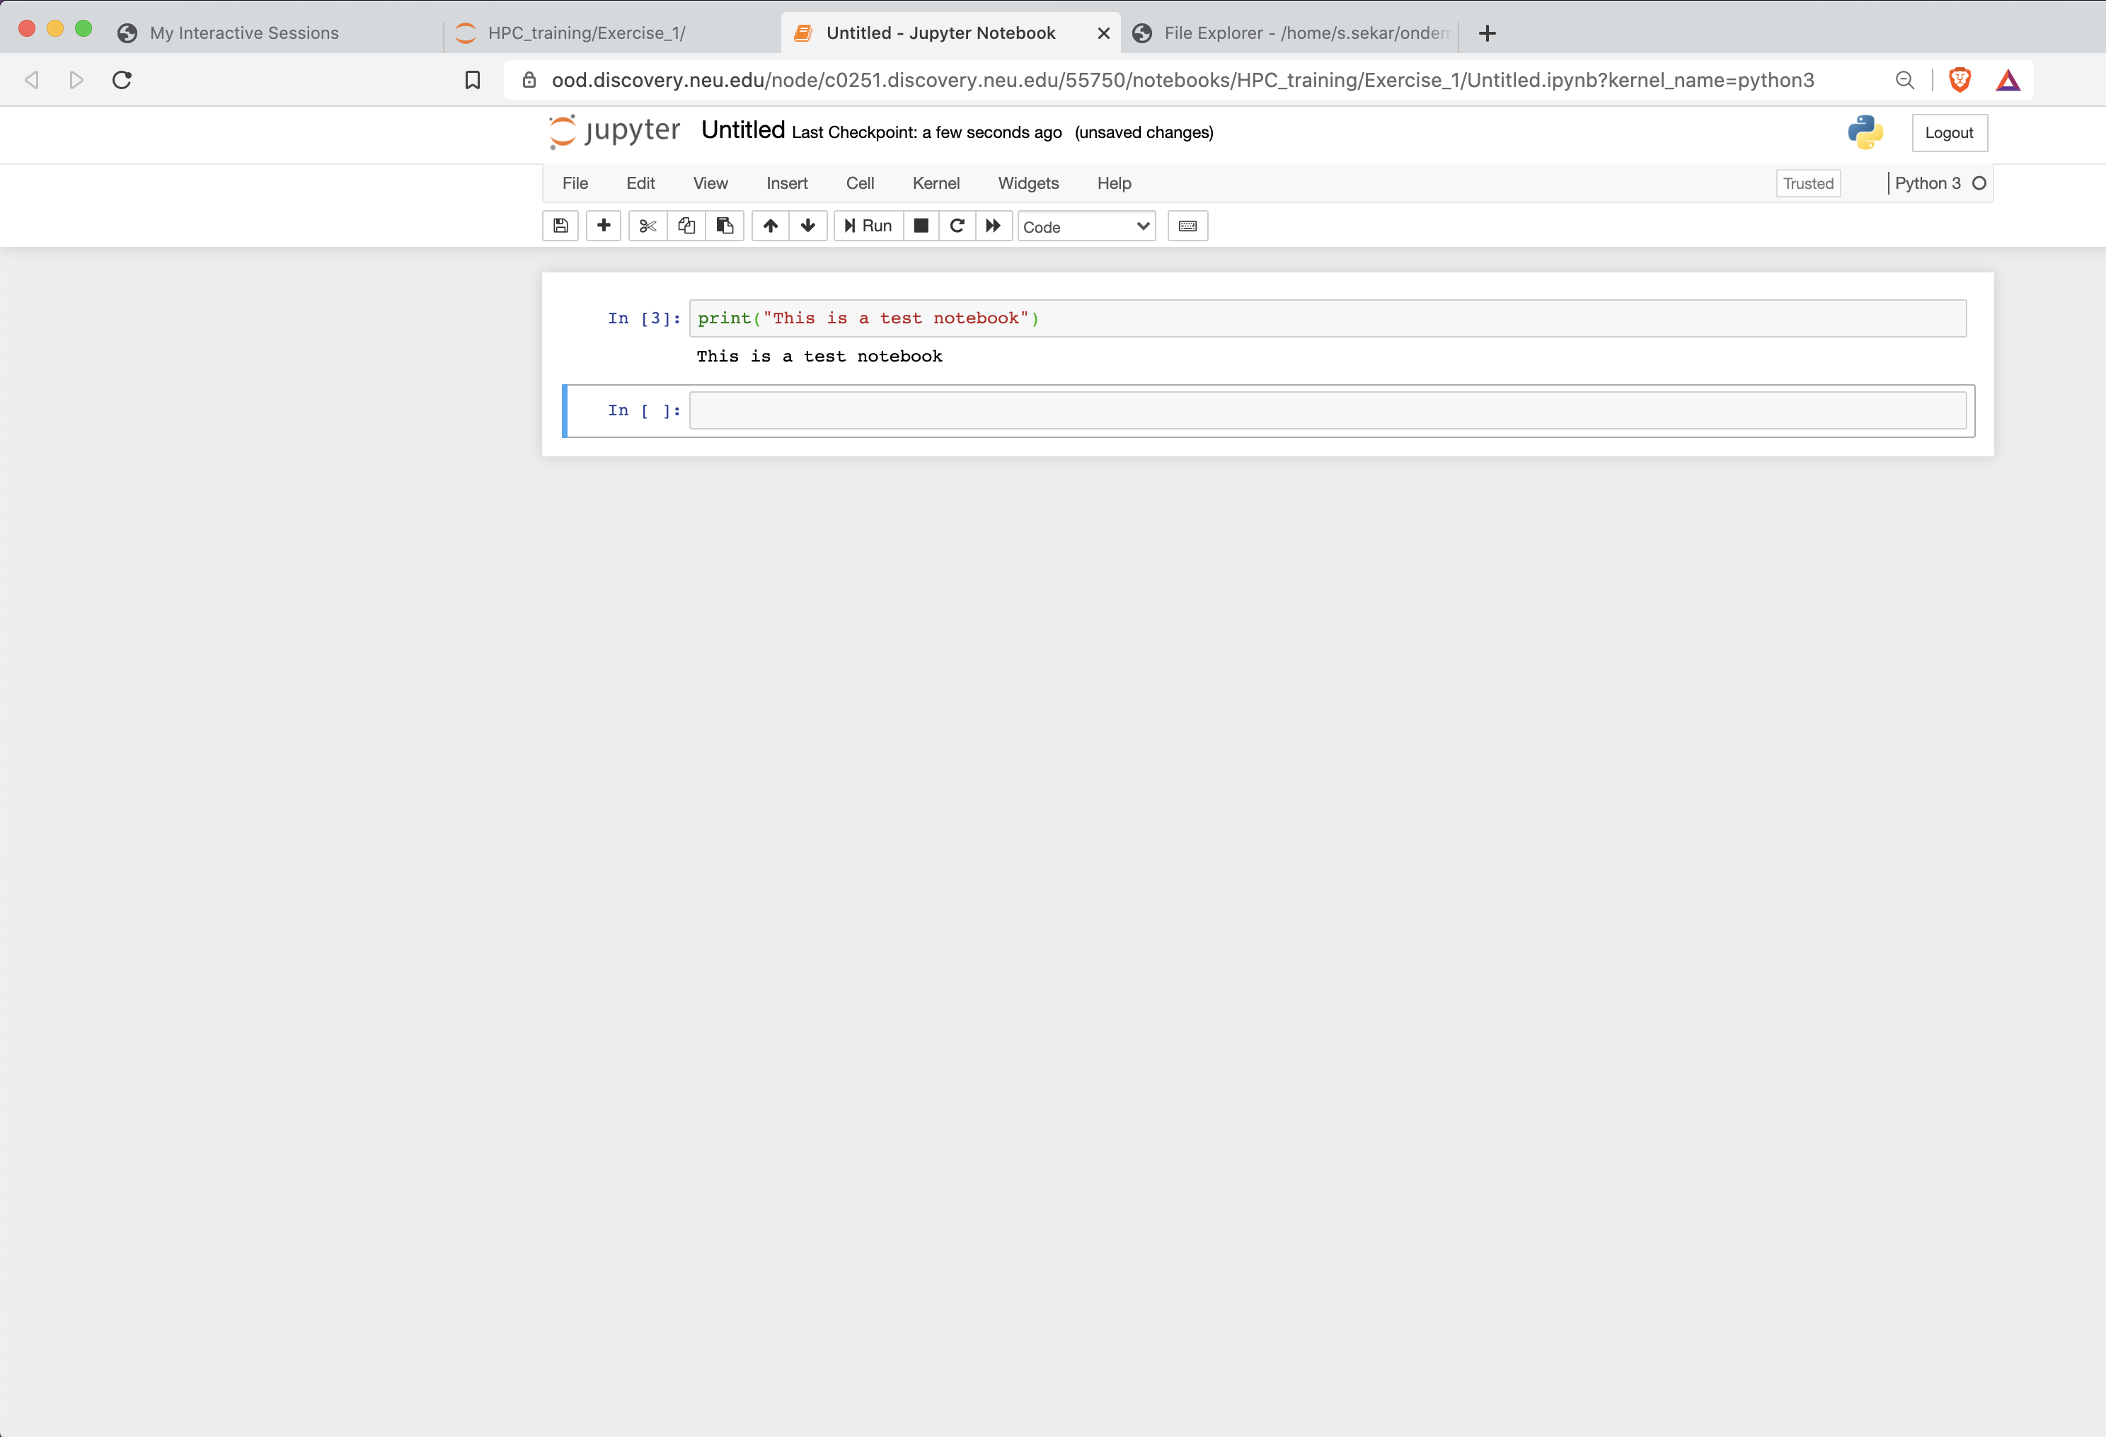
Accessing Jupyter Notebook on OOD

Slide 23
Exercise 3
In this exercise, we will run an example jupyter notebook
Launch a jupyter notebook session and open the JupyterNB_example.ipynb file from the Exercise3 directory
Click on each cell starting with the first one and run them one after the other

Slide 24
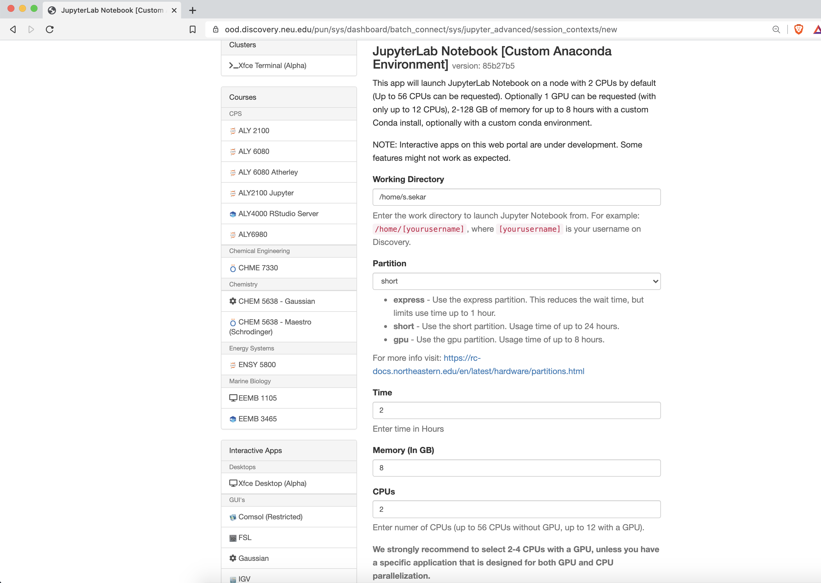
Accessing JupyterLab Notebook on OOD (with custom conda env)

Slide 25
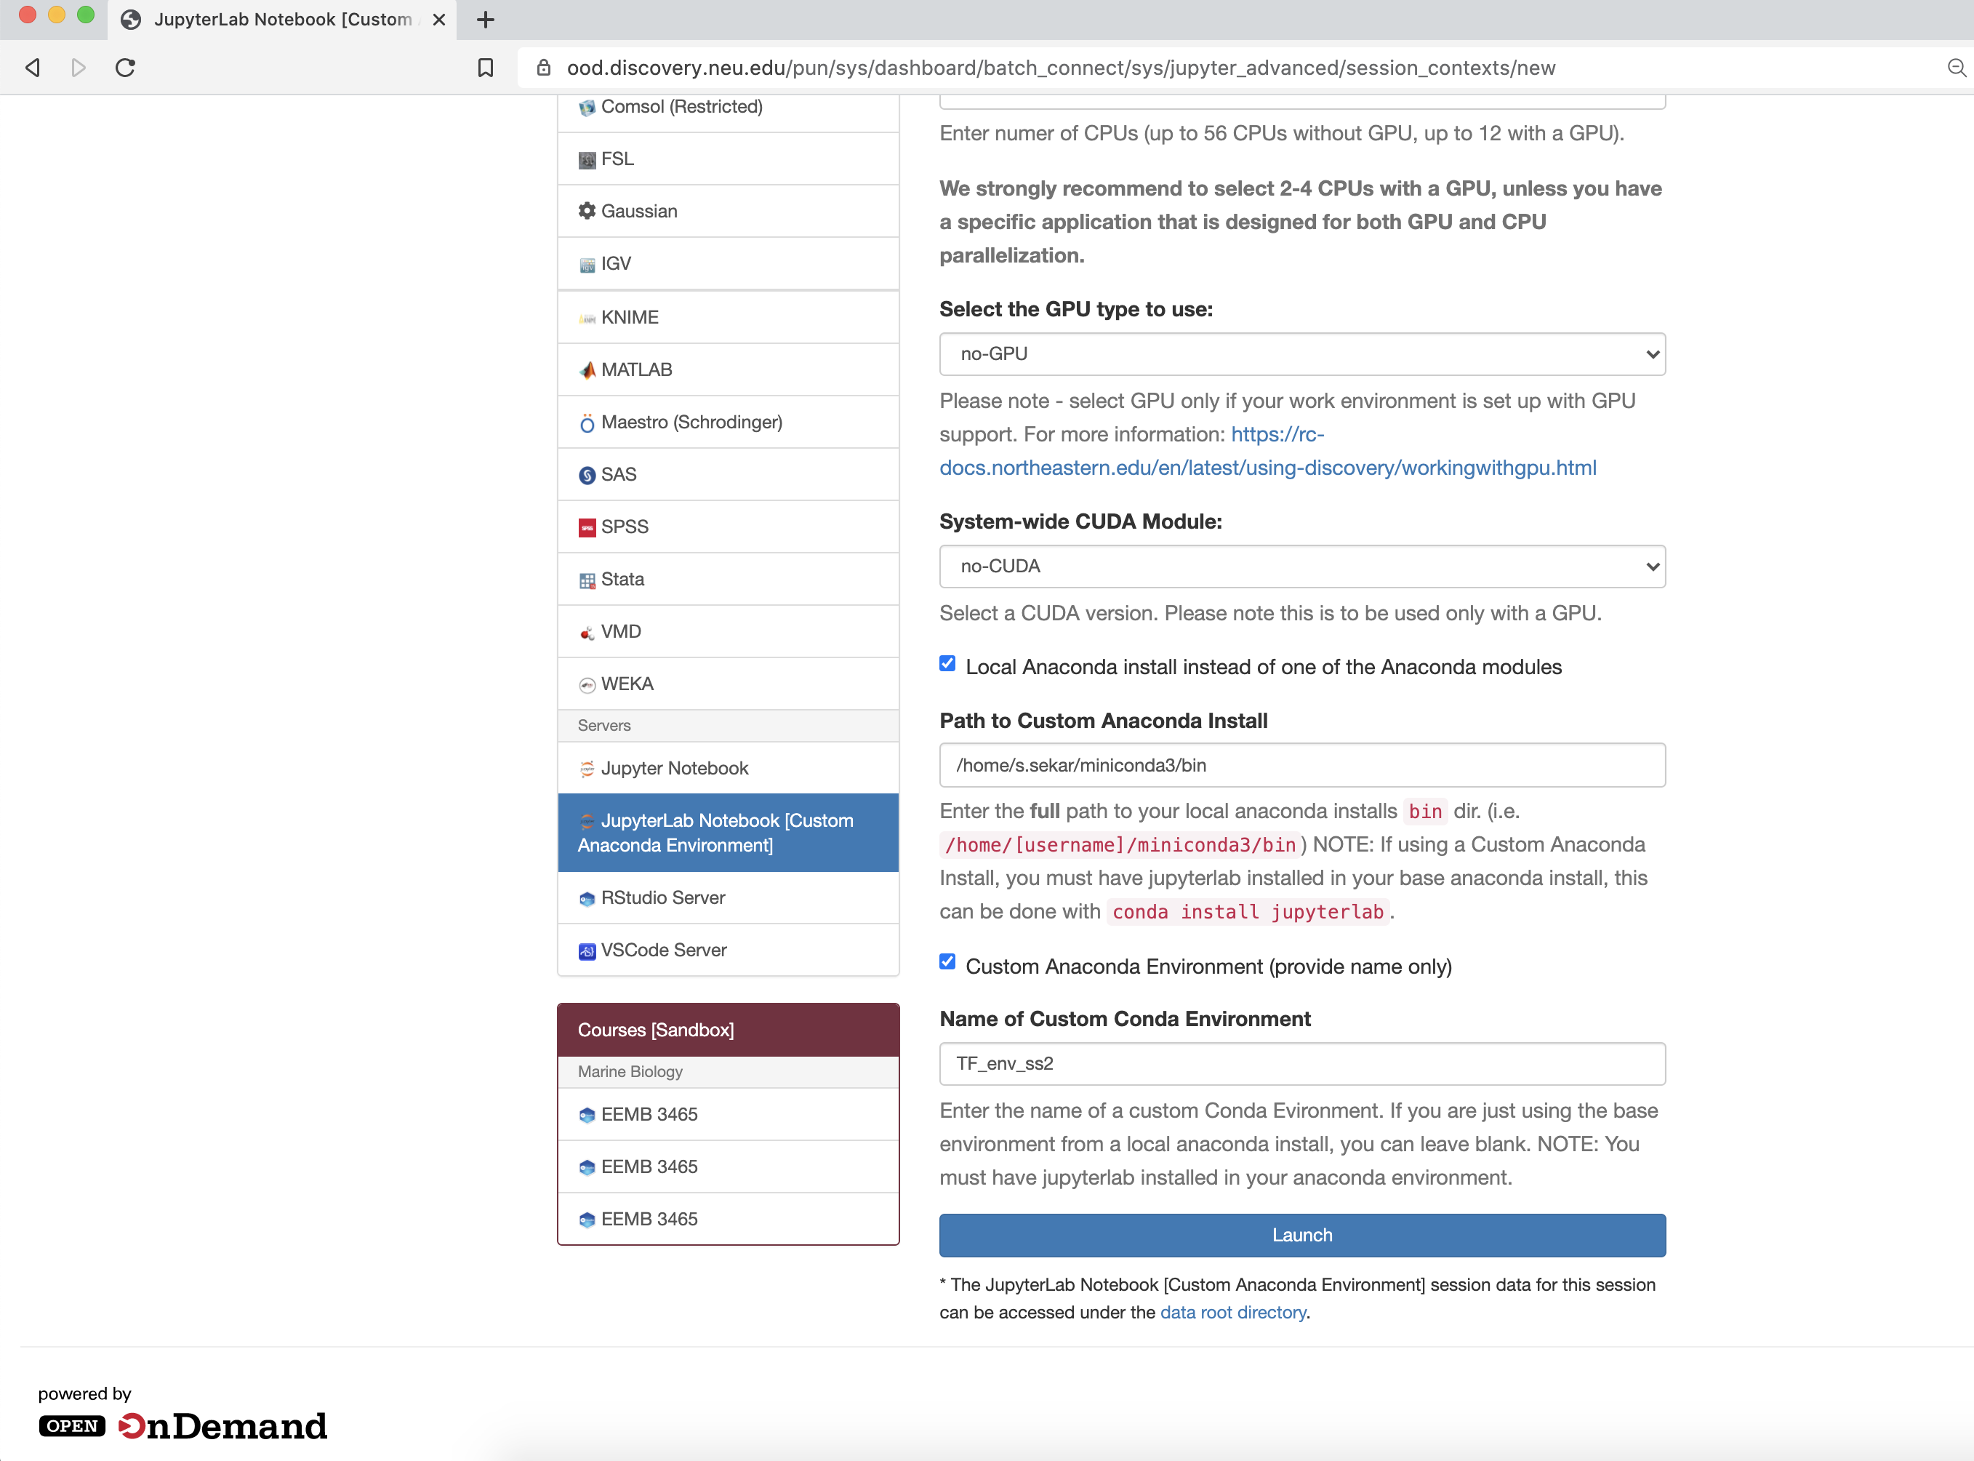
Accessing JupyterLab Notebook on OOD (with custom conda env)

Slide 26
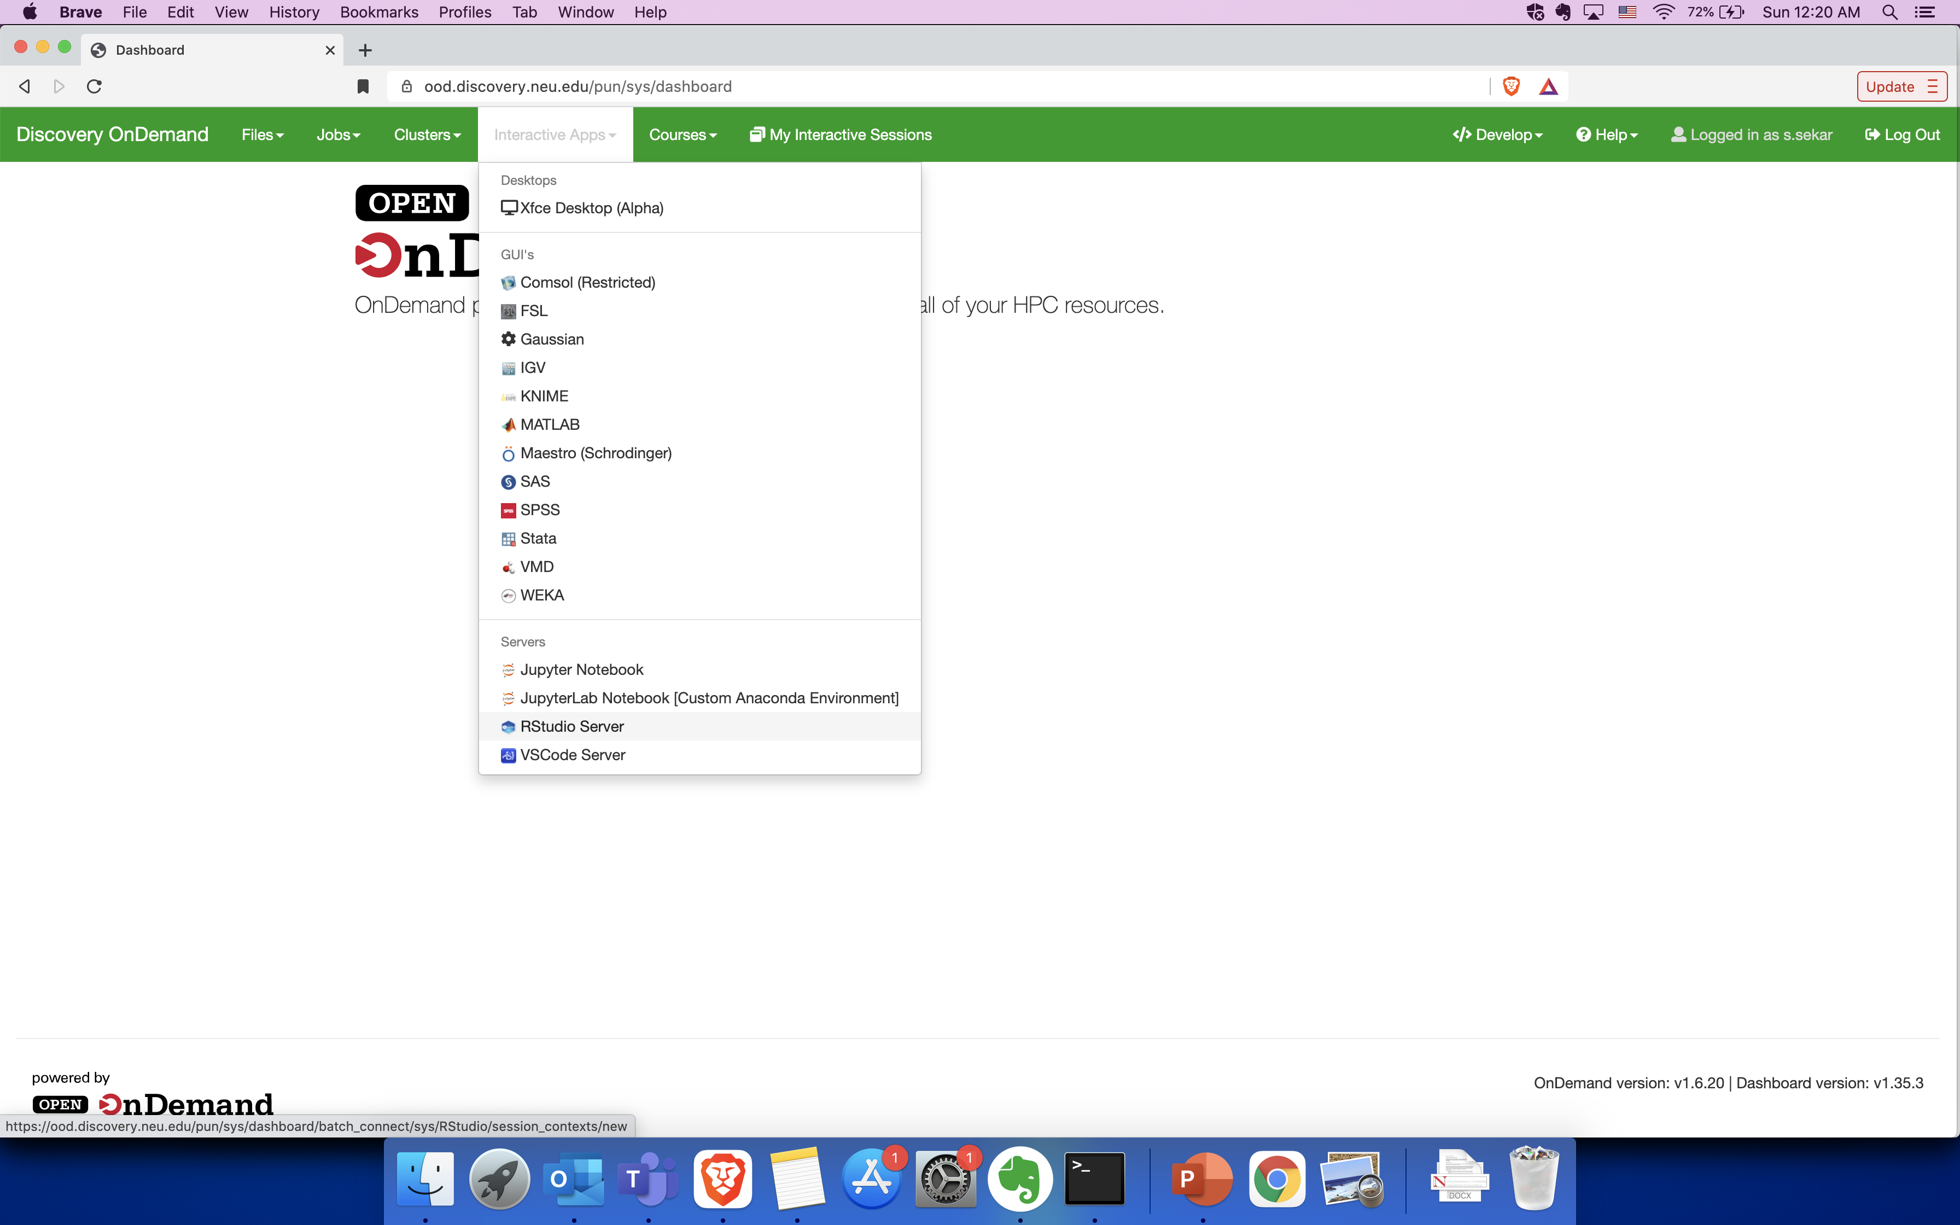
Accessing RStudio on OOD
To launch an RStudio session on a compute node, go to Interactive Apps > RStudio Server

Slide 27
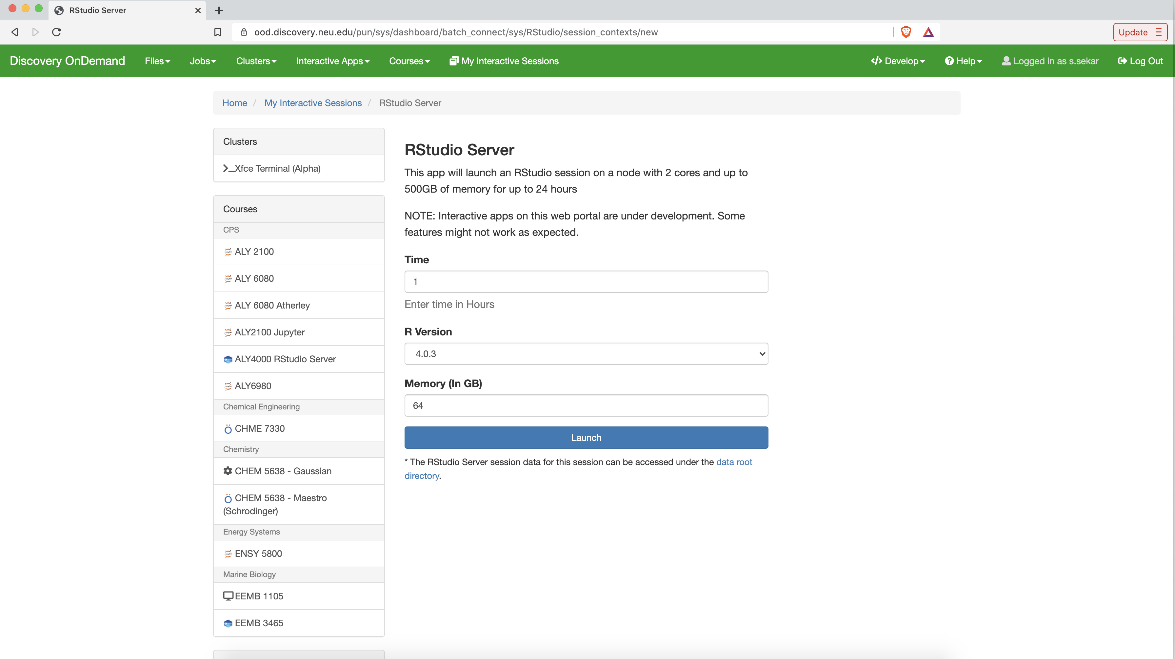
Accessing RStudio on OOD
Select the time, R version and memory required for your session, and click on ‘Launch’

Slide 28
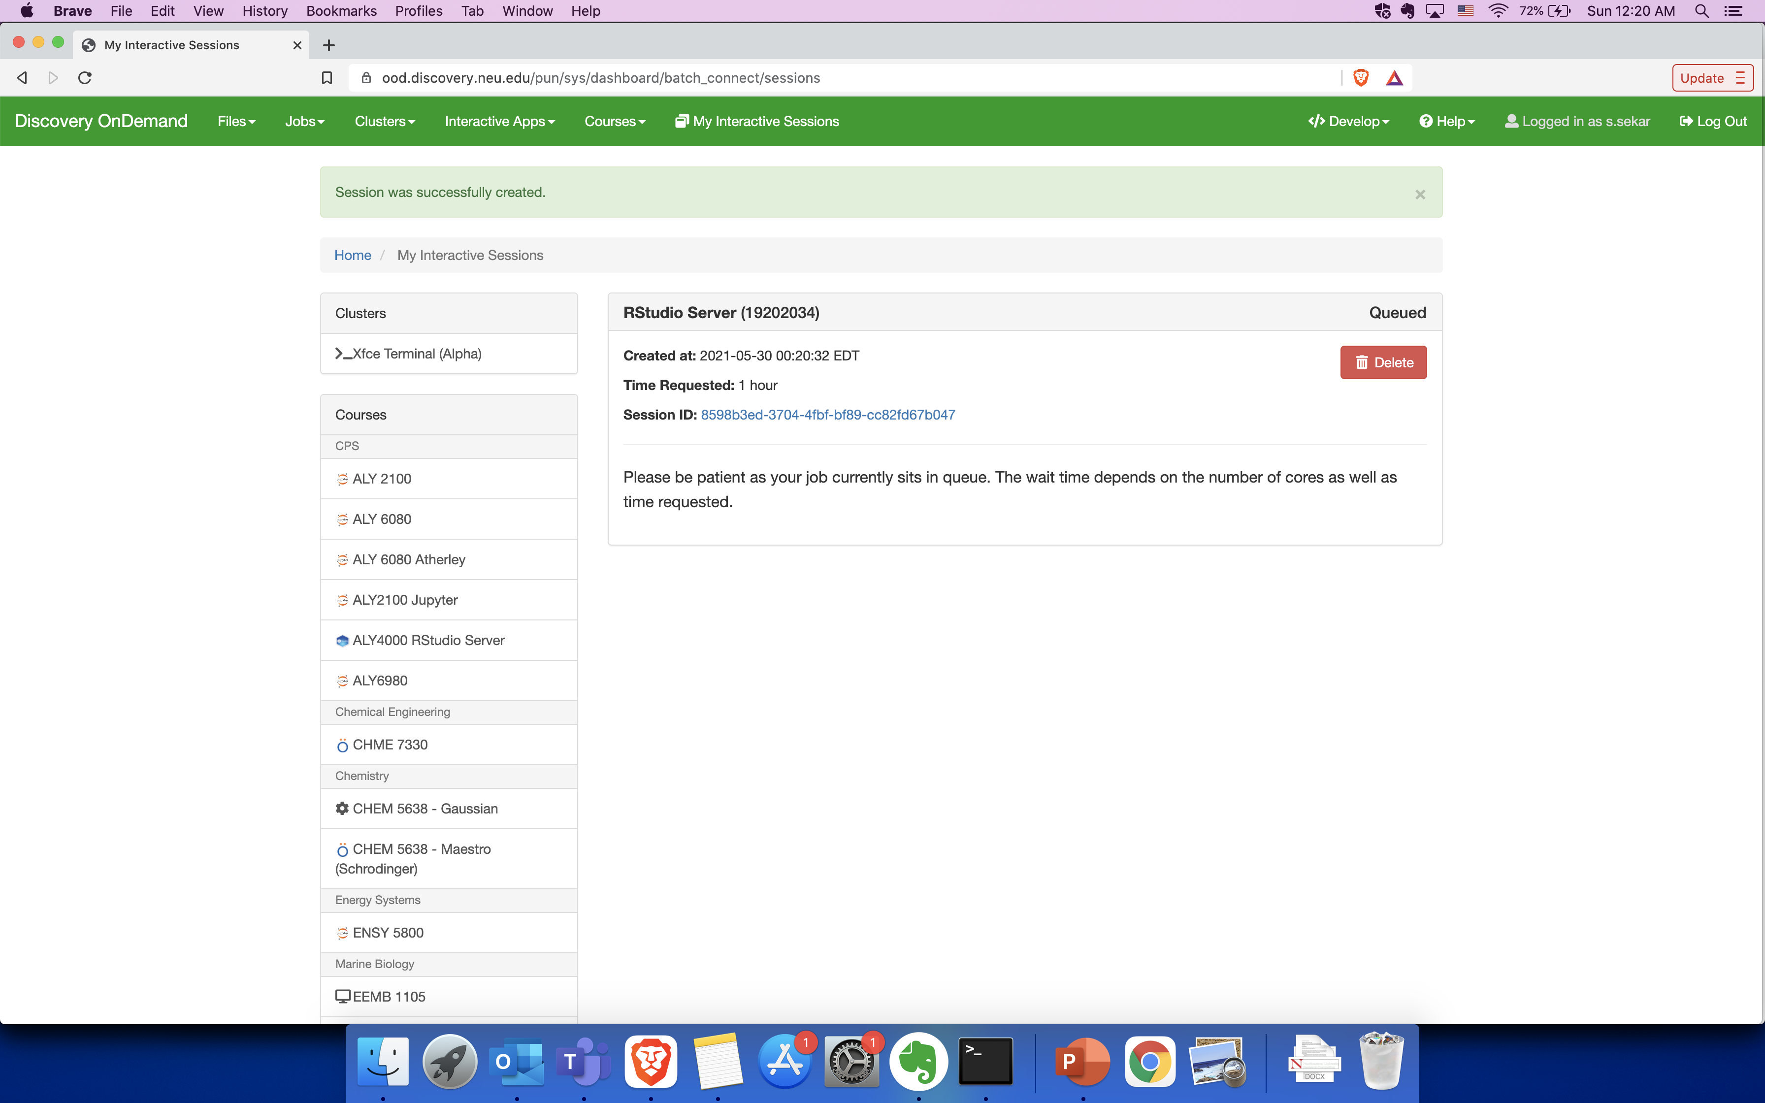
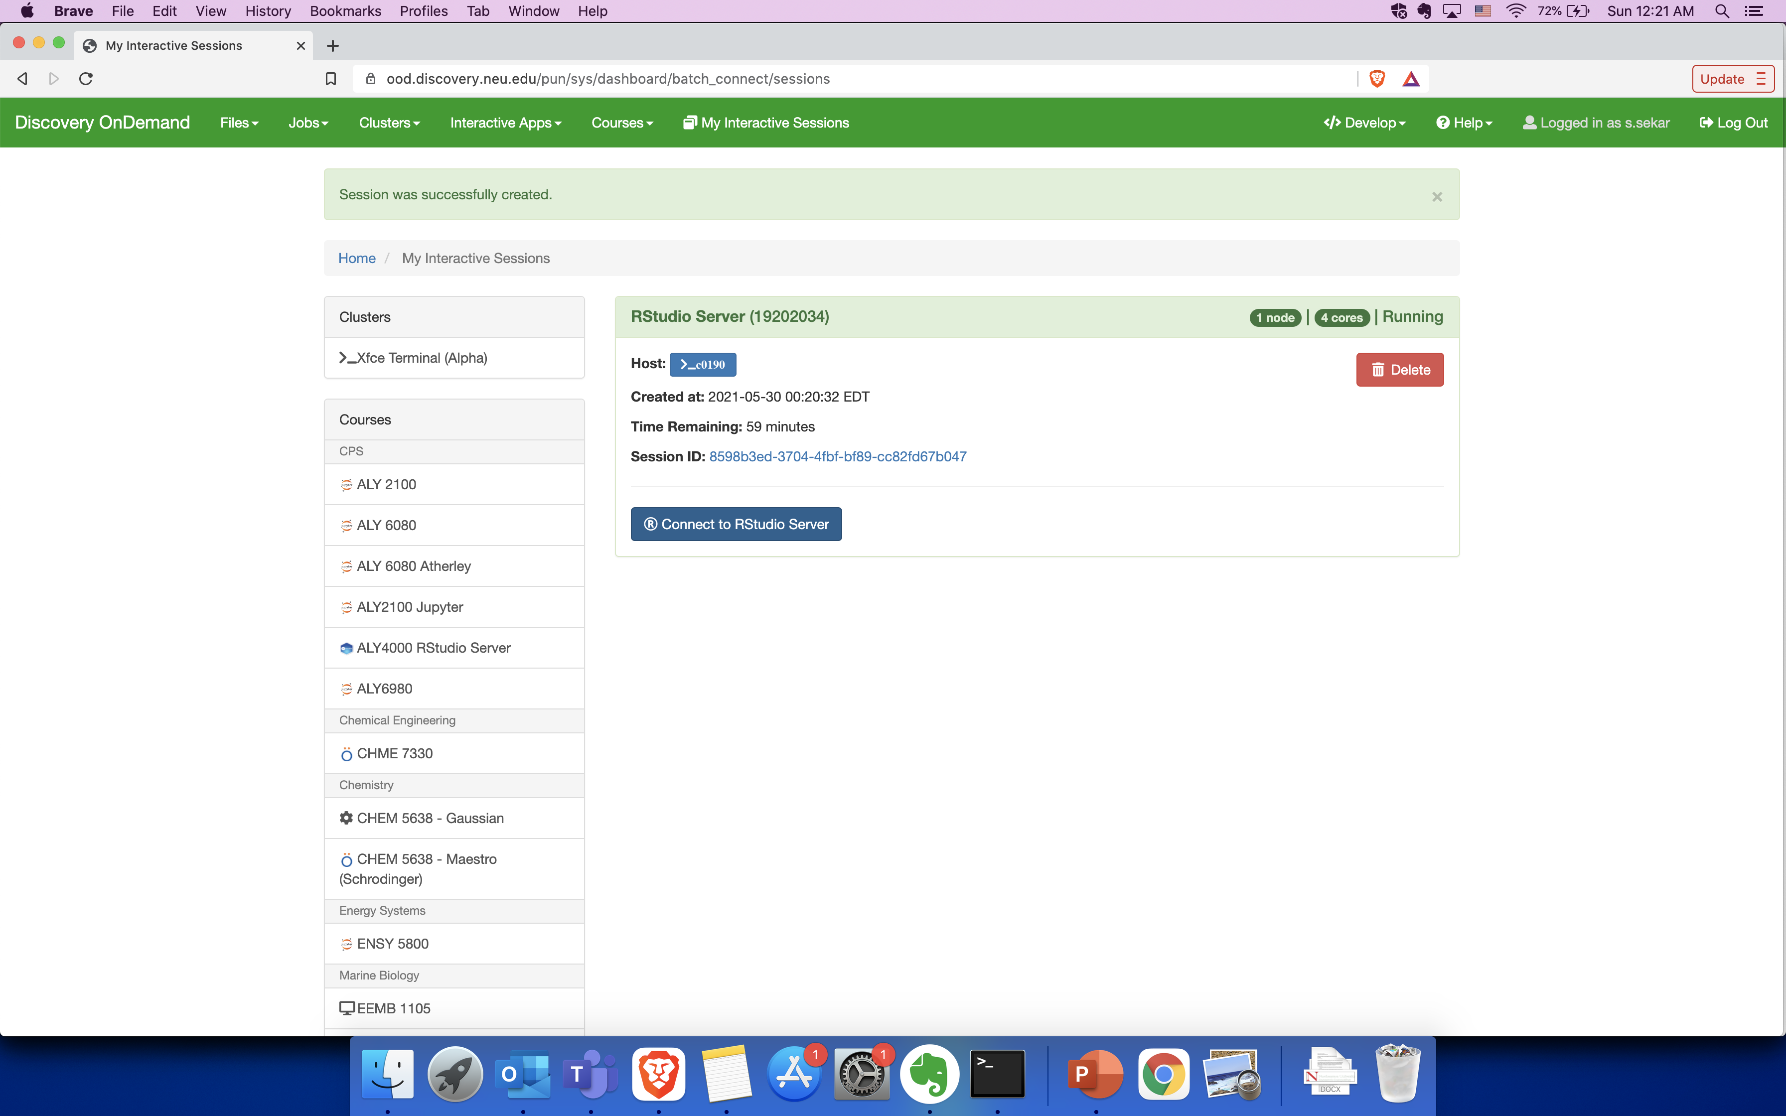
Accessing RStudio on OOD
Your job will now go to the queue and wait for resources to be allocated
Once the requested resources have been allocated,
you can click on ‘Connect to Rstudio Server’

Slide 29
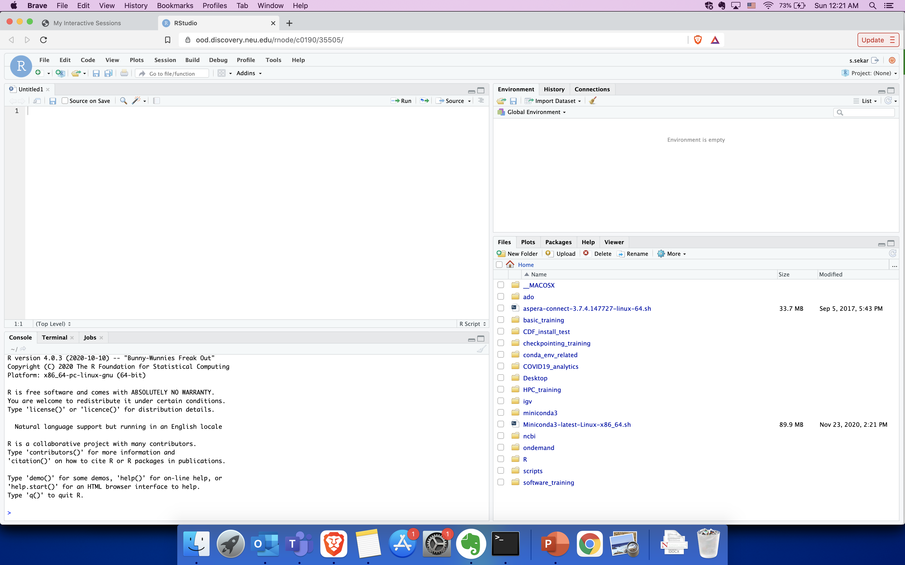
Accessing RStudio on OOD
You may now use RStudio on OOD

Slide 30
Exercise 4 (optional)
In this exercise, we will run simple R script in the RStudio session
Launch an RStudio session and open Sample_Rplot.R file from the Exercise4 directory
Run the commands in the script to
install a package
View an in-built dataset
Plot a simple histogram using the installed package

